Slide 1
IMDB Movie Analysis With PowerBI

Slide 2
Approach
Data cleaning
Drop unwanted Columns
Handle null values
Visualizations
Use power bi for analysis.

Slide 3
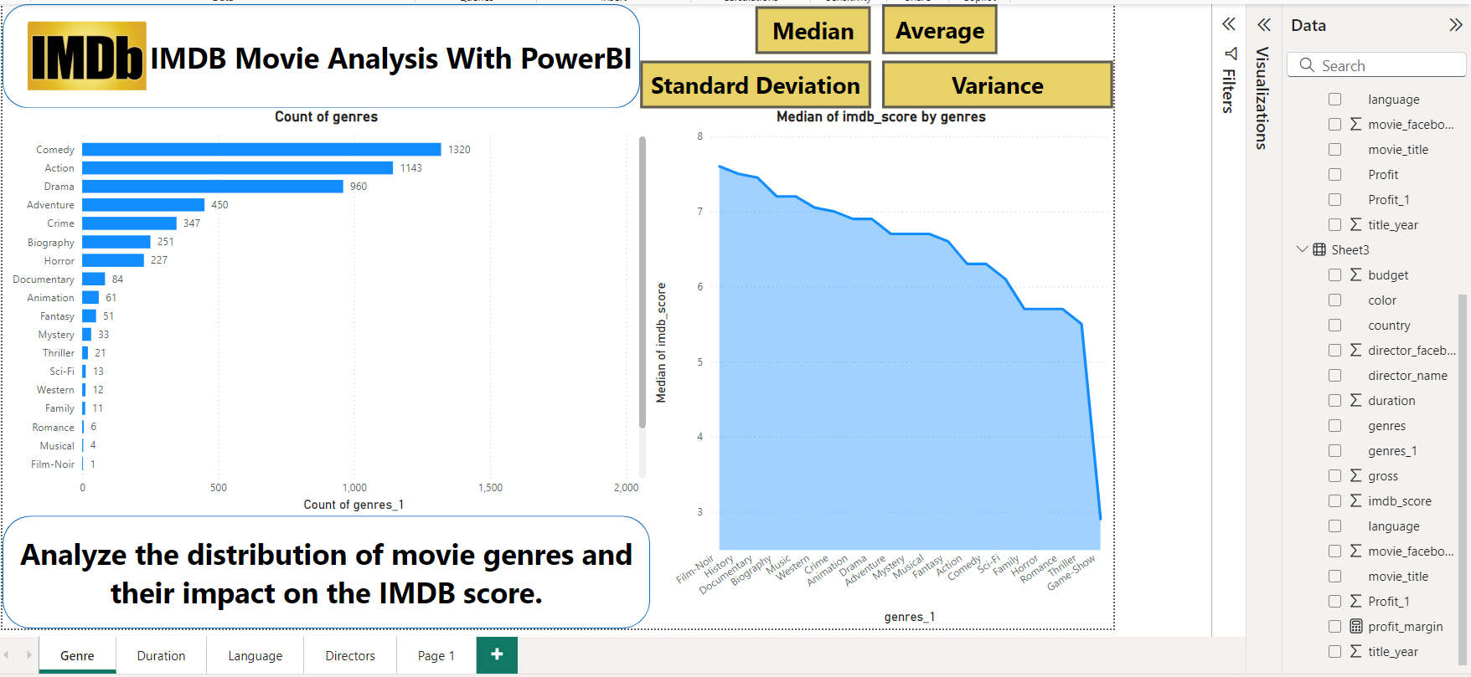
Movie Genre Analysis

Slide 4
Movie Genre Analysis
The most common genres of movies are Comedy, Action, Drama, Adventure, and Crime.
Descriptive Statistics
Mean: 240.14
Median: 33
Variance: 164469
Standard Deviation: 405.54
Range: 1329
some movie genres get more attention, there's no pattern or formula for success.
Mean | 240.1428571
Median | 33
Mode | 1
Standard Deviation | 405.5478129
Sample Variance | 164469.0286
Range | 1328
Minimum | 1
Maximum | 1329
Count | 21

Slide 5
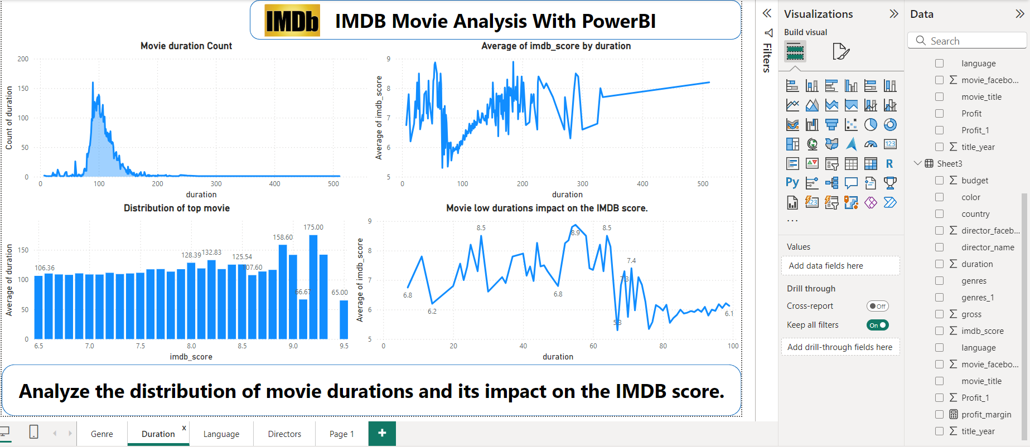
Movie Duration Analysis

Slide 6
Movie Duration Analysis
Most data points fall within the duration of 100 - 160 minutes, indicating no significant relationship between duration and IMDb score.
Even low duration movies also have high ratings.
Most of people like to watch around 1.5 – 2.5hr.
Lengthy movies have less viewers.
So its not about length, it’s about people enjoying or not during the time length.

Slide 7
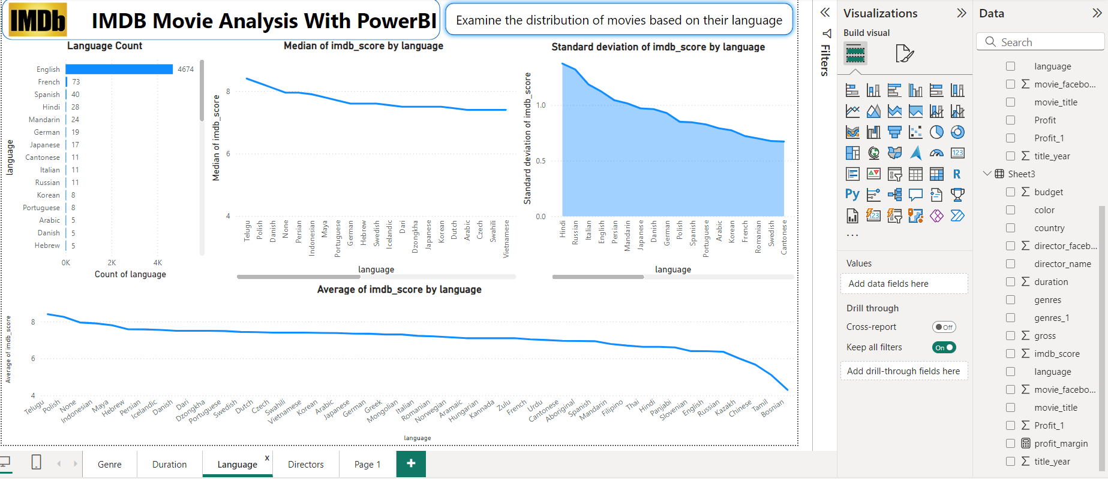
Language Analysis

Slide 8
Language Analysis
The most common languages used in movies english, french, spanish, hindi, mandarin.
Language is not impact the movie IMDB score.
English is the most popular language for movies, but that doesn't mean other language movies can't be a get high IMDB score.
Which impact the IMDB score is, is people connect with the story or not that’s would decided movie’s rating.

Slide 9
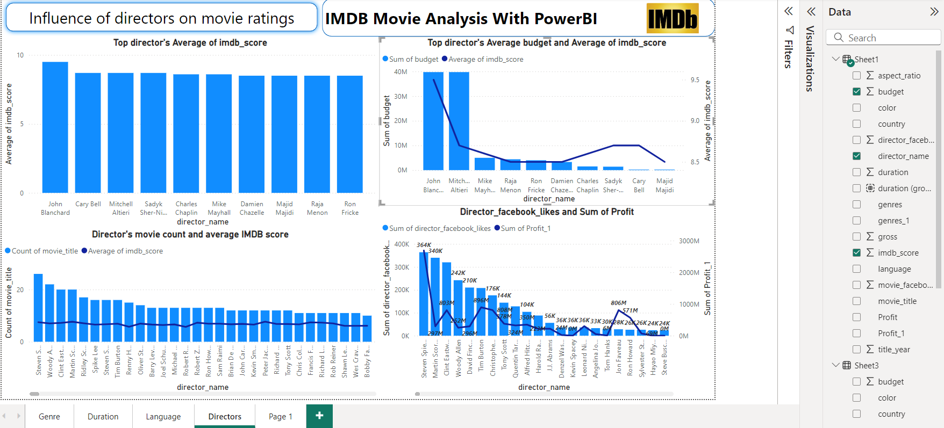
Director Analysis

Slide 10
Director Analysis
The top 5 directors based on their average IMDB score John blanchrd, cary bell, mitchel altieri, sady she-niyas and charles chaplin.
The director’s face book like or their movie budget are not affect the IMDB score.
The directors are impact the IMDB score.
Talented directors are make movies special, that way their impact the IMBD score.

Slide 11
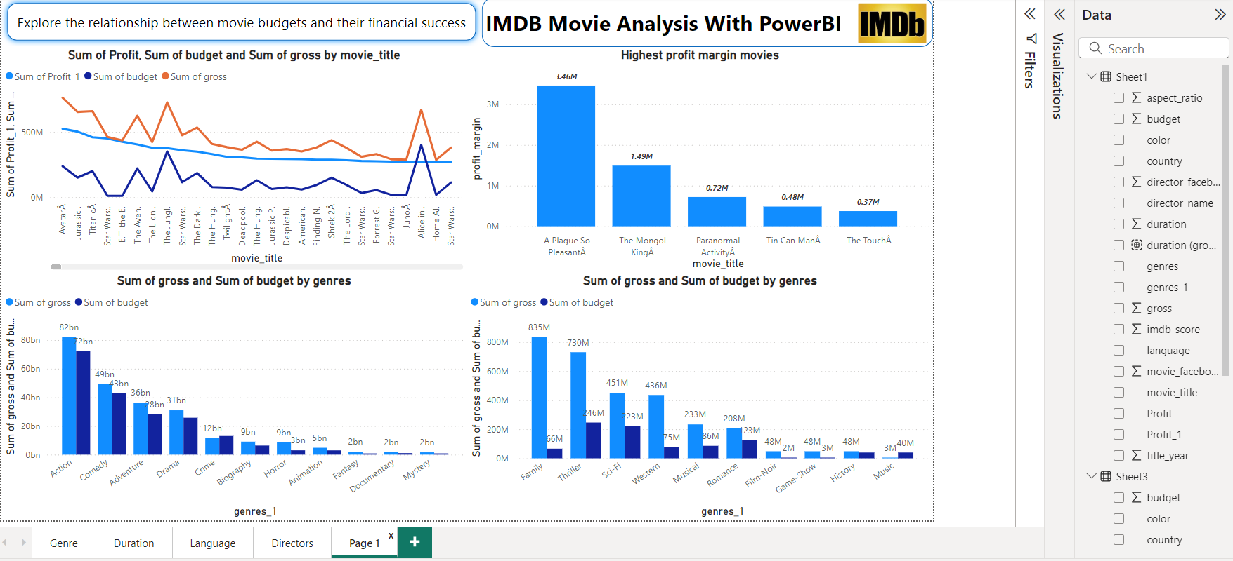
Budget Analysis

Slide 12
Budget Analysis
The top 5 profit margin movies are A plague so plasent, The mangol king, Paranormal, Tin can man and the touch.
There is no relation between budget and profit margin.
A low budget movies also reach high profit margin.
Money is important, but it not applicable for all cases.
Some good movies make huge profit, it doesn’t have big budget.

Slide 13
Conclusion
Success of movie is not about genre, duration or language it’s all about quality of content.
Some case director and budget helps success of movies, not for all.
High budget movies also got flop, so its not secret formula.
Therefore by understanding these factors everyone loves on IMDB movies.

